Slide 1
Ethernet
Network Fundamentals – Chapter 9

Slide 2
Objectives
Identify the basic characteristics of network media used in Ethernet.
Describe the physical and data link features of Ethernet.
Describe the function and characteristics of the media access control method used by Ethernet protocol.
Explain the importance of Layer 2 addressing used for data transmission and determine how the different types of addressing impacts network operation and performance.
Compare and contrast the application and benefits of using Ethernet switches in a LAN as apposed to using hubs.
Explain the ARP process.

Slide 3
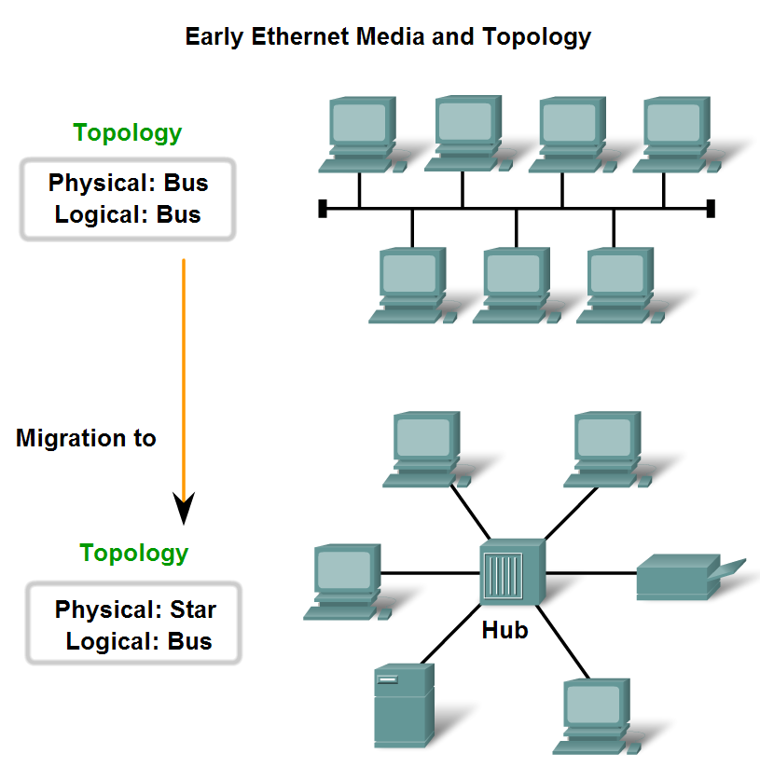
Characteristics of Network Media used in Ethernet
Identify several characteristics of Ethernet in its early years

Slide 4
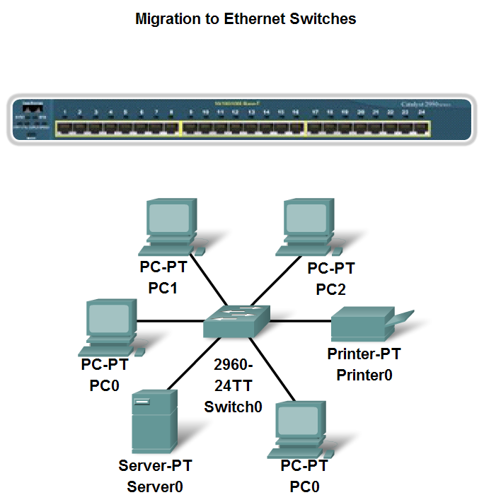
Characteristics of Network Media used in Ethernet
Describe the emergence of the LAN switch as a key innovation for managing collisions on Ethernet-based networks

Slide 5
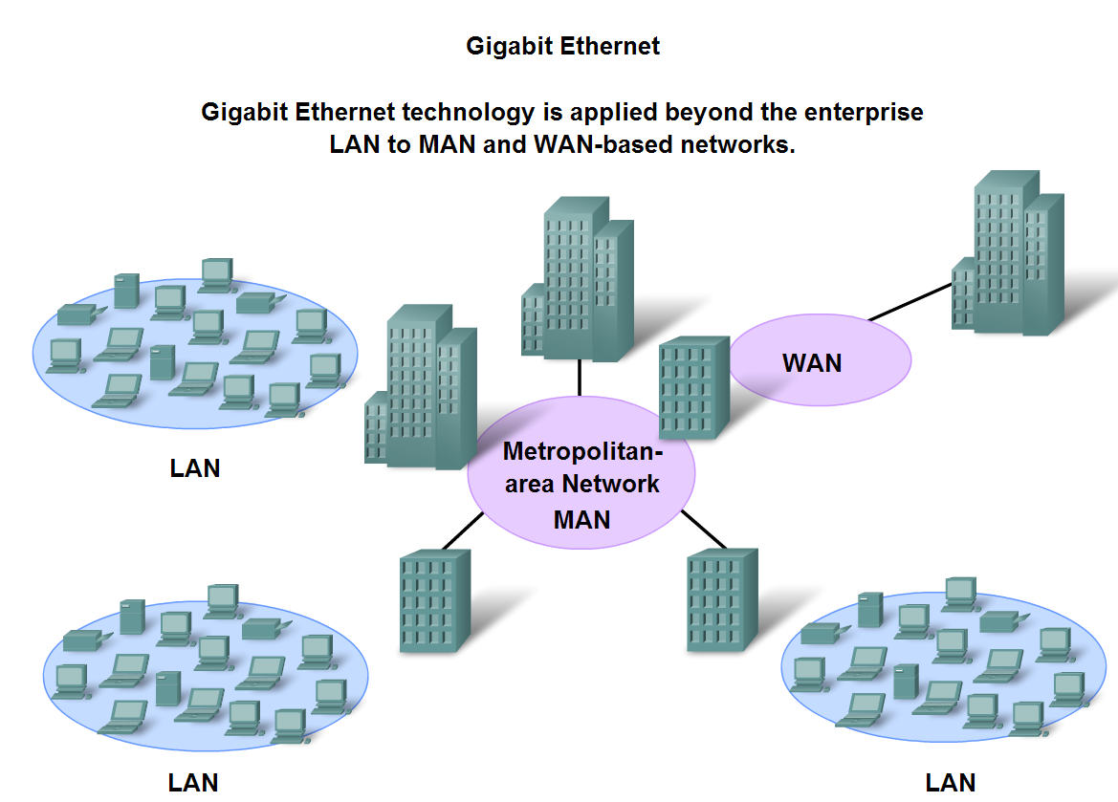
Characteristics of Network Media used in Ethernet
Identify the characteristics of state-of-the-art Ethernet and describe its utilization of cabling and point-to-point topography

Slide 6
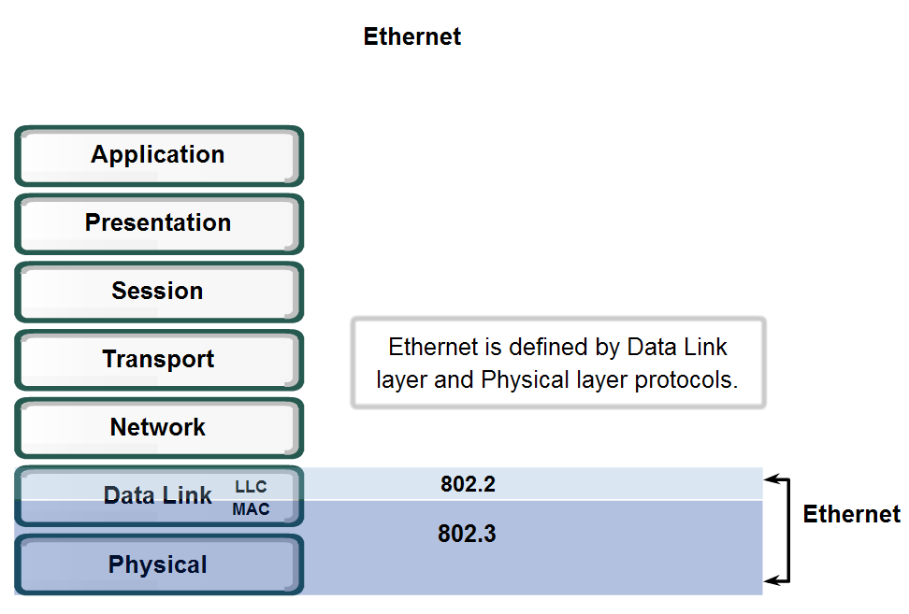
Physical and Data Link Features of Ethernet
Standards and Implementation

Slide 7
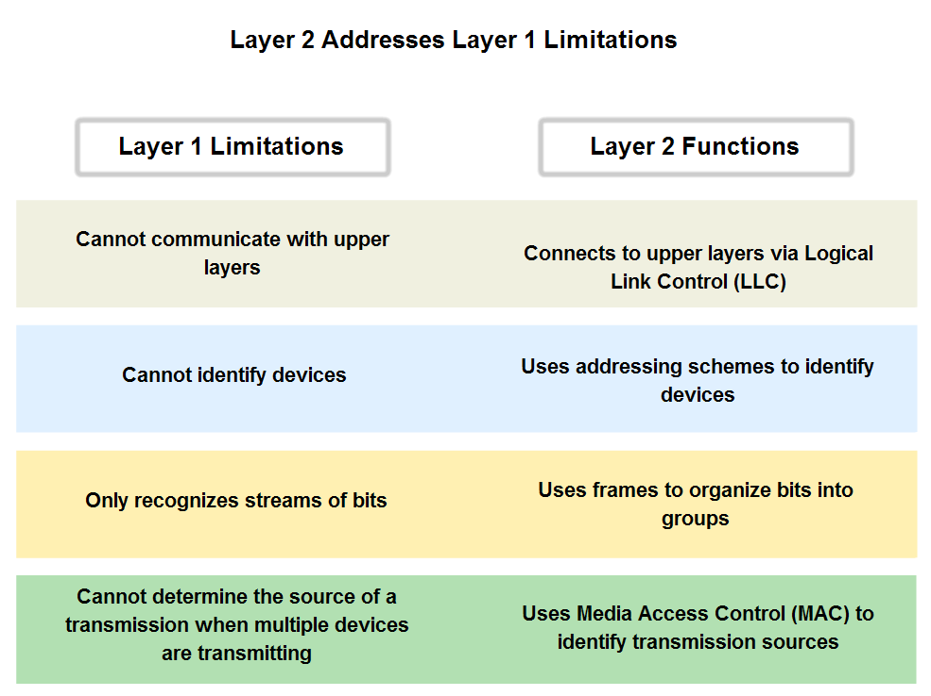
Physical and Data Link Features of Ethernet
Describe how the Ethernet operates across two layers of the OSI model

Slide 8
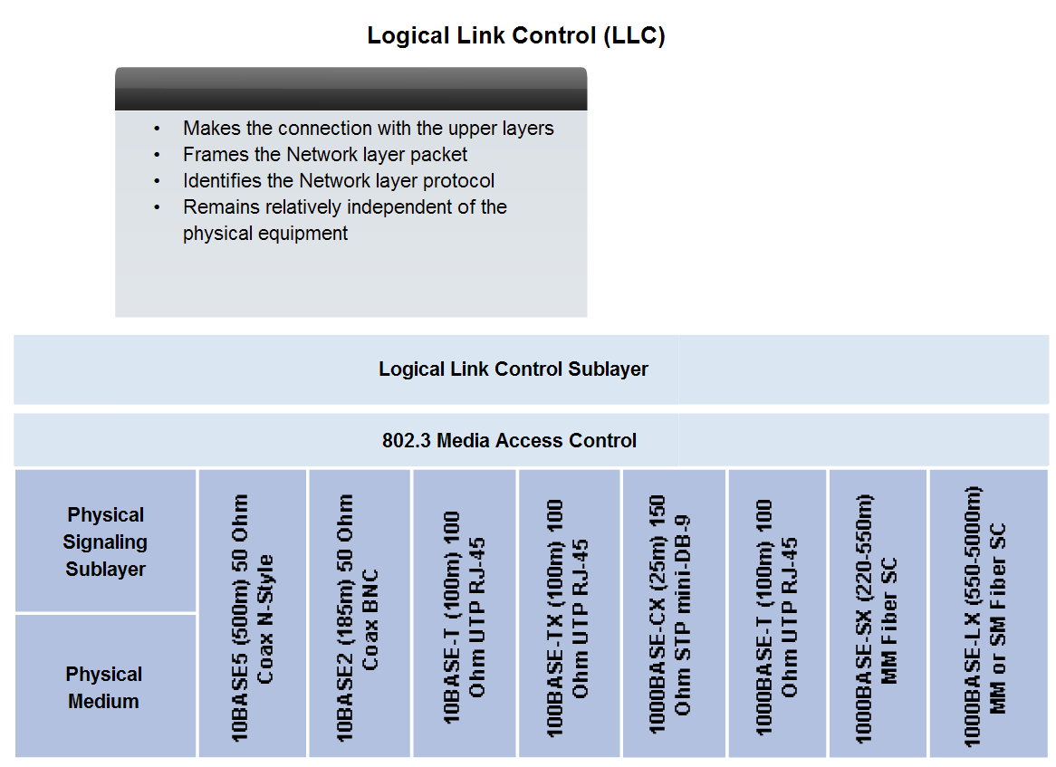
Physical and Data Link Features of Ethernet
Logic Link Control – Connecting the Upper Layers

Slide 9
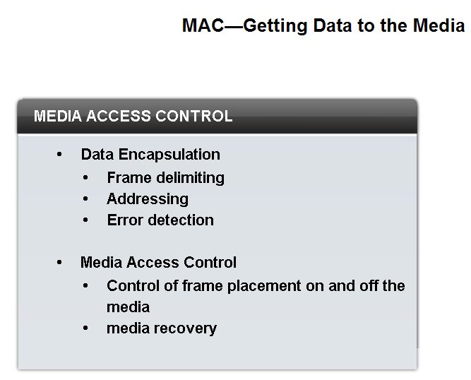
Physical and Data Link Features of Ethernet
Media Access Control (MAC)

Slide 10
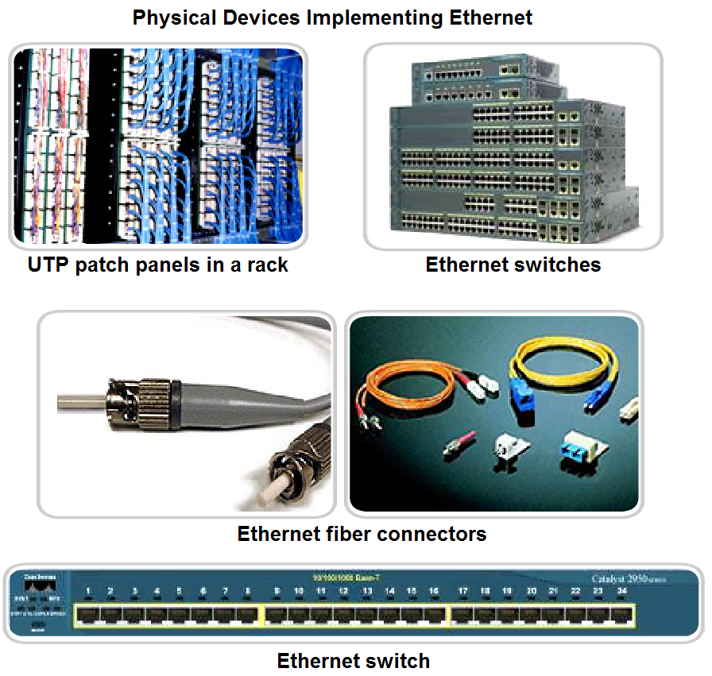
Physical and Data Link Features of Ethernet
Physical Implementations of the Ethernet

Slide 11
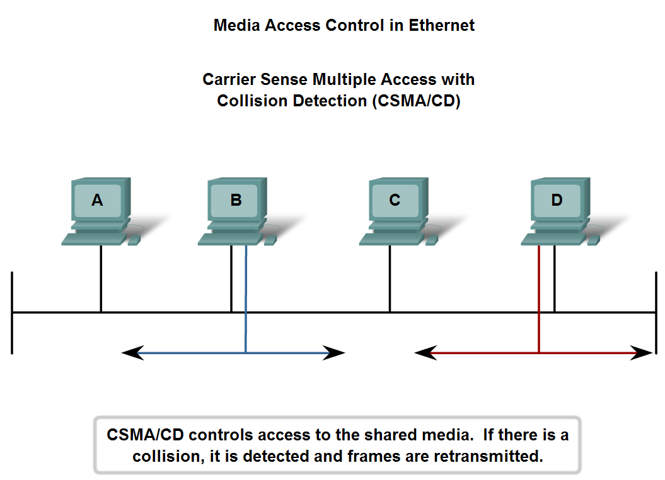
Function and Characteristics of the Media Access Control Method
MAC in Ethernet

Slide 12
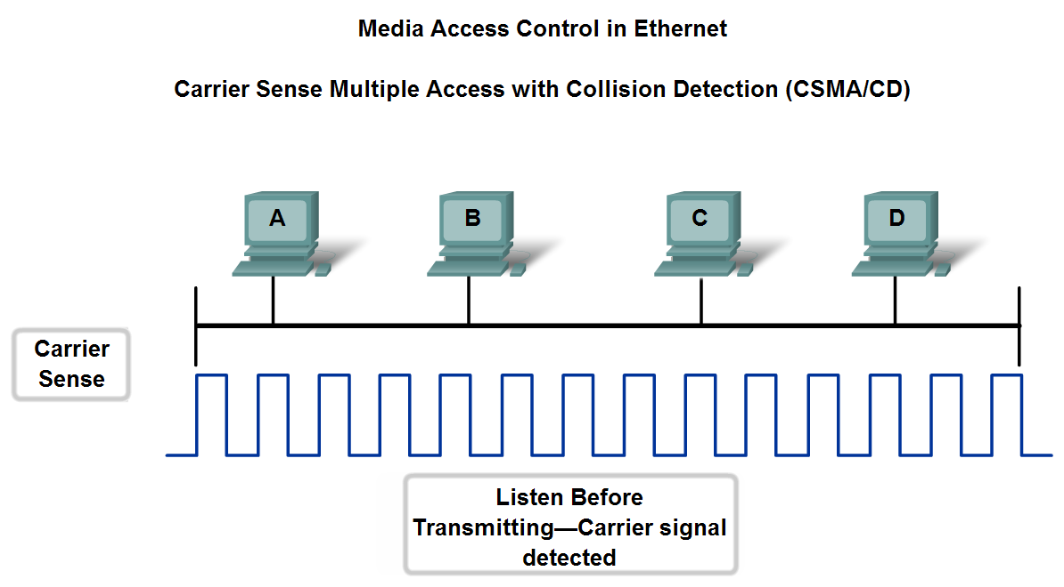
Function and Characteristics of the Media Access Control Method
Carrier Sense Multiple Access with Collision Detection

Slide 13
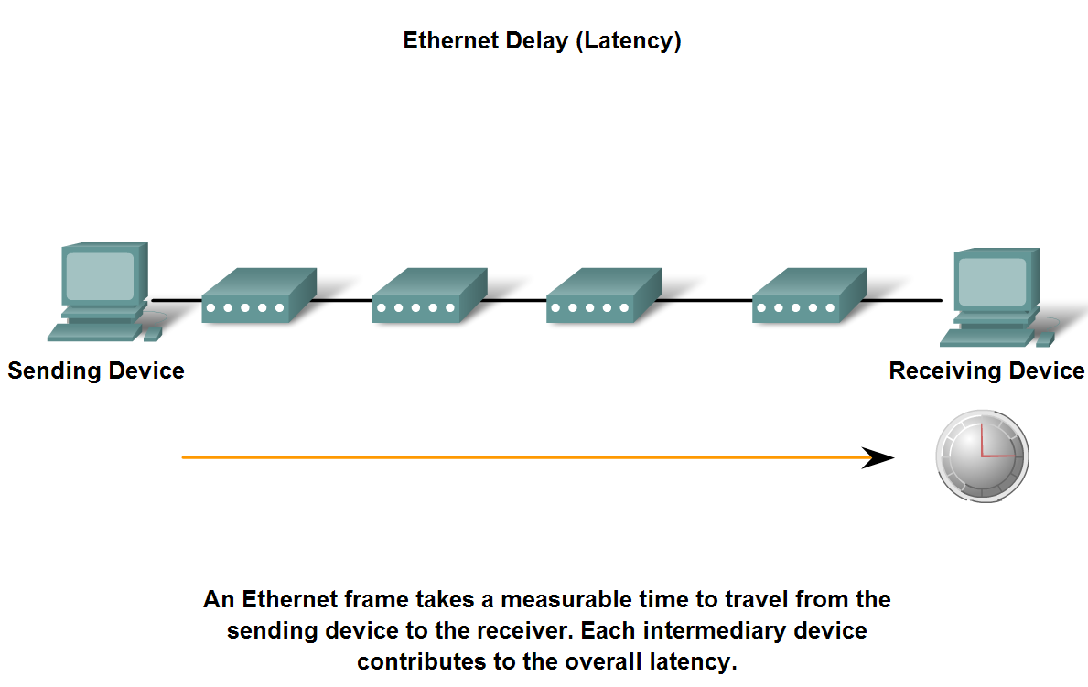
Function and Characteristics of the Media Access Control Method
Ethernet Timing

Slide 14
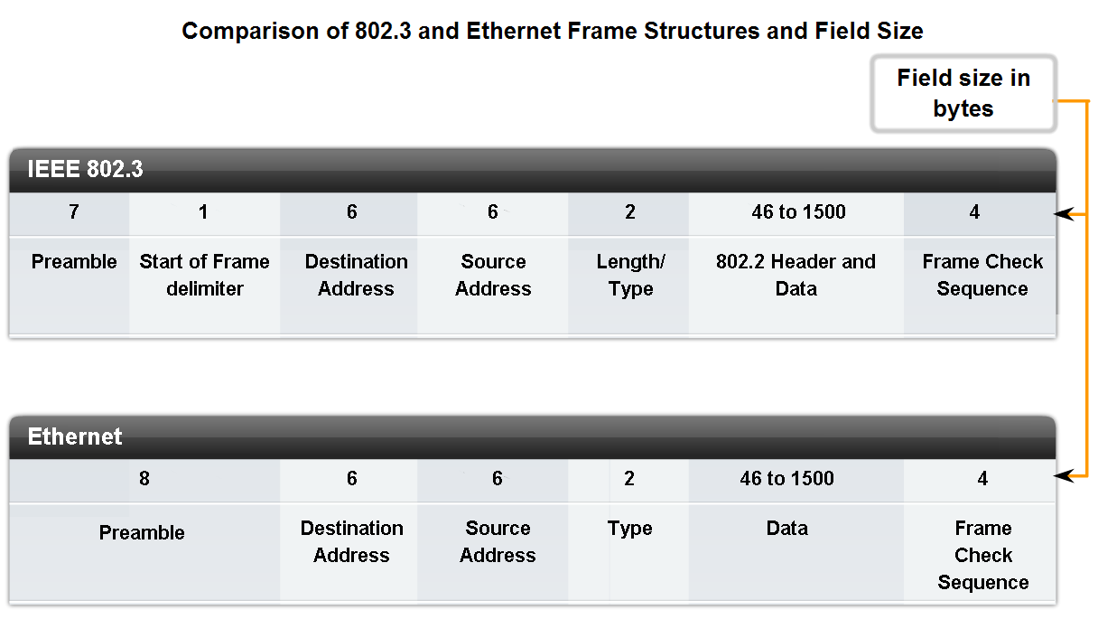
Layer 2 Addressing and Its Impact on Network Operation and Performance
The Frame – Encapsulating the Packet

Slide 15
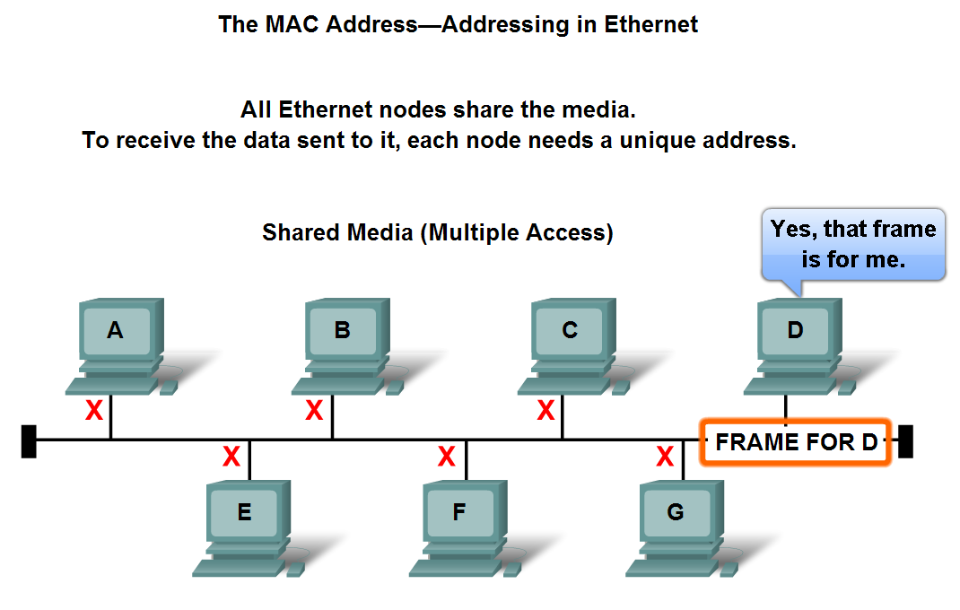
Layer 2 Addressing and Its Impact on Network Operation and Performance
The Ethernet MAC Address

Slide 16
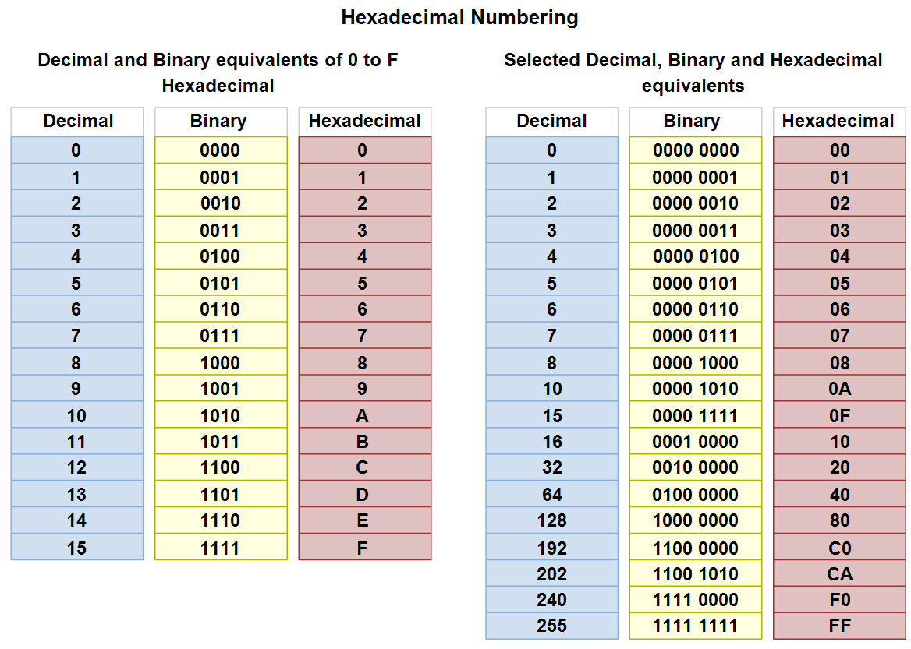
Layer 2 Addressing and Its Impact on Network Operation and Performance
Hexadecimal Numbering and Addressing

Slide 17
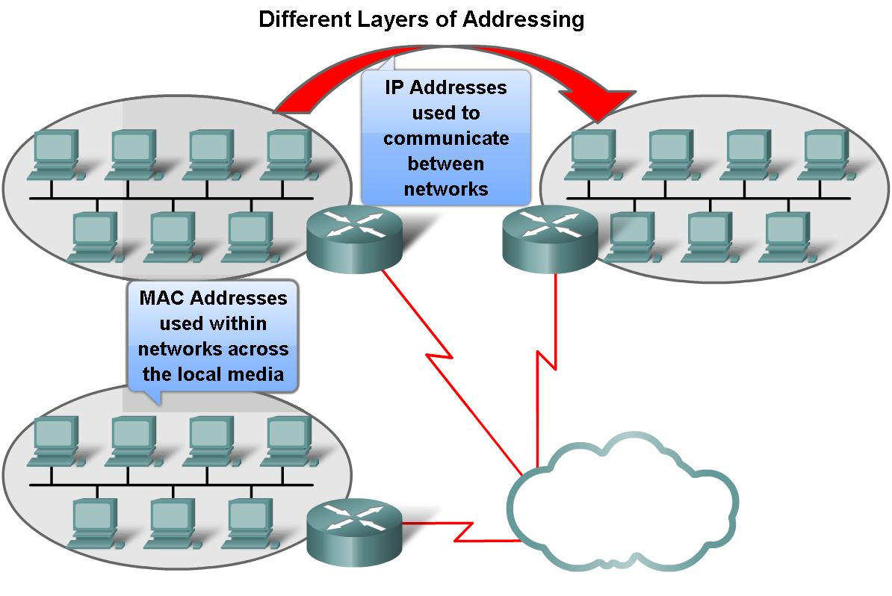
Layer 2 Addressing and Its Impact on Network Operation and Performance
Another Layer of Addressing

Slide 18
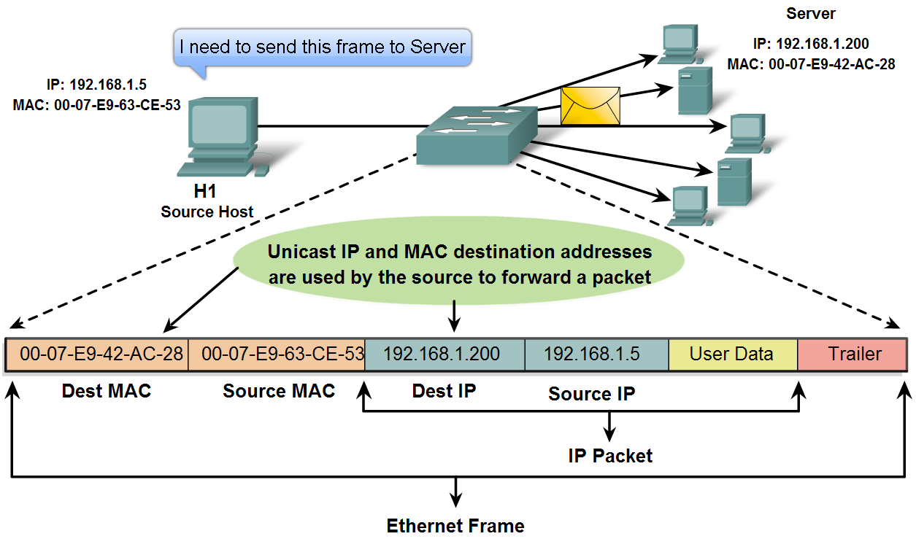
Layer 2 Addressing and Its Impact on Network Operation and Performance
Ethernet Unicast, Multicast and Broadcast

Slide 19
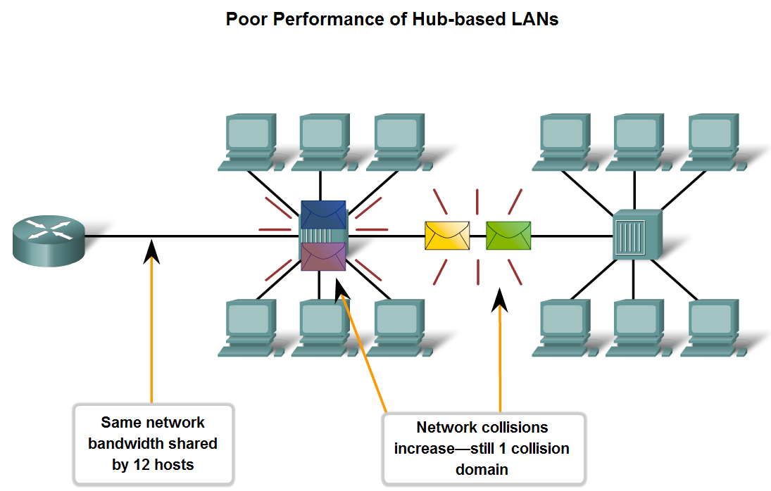
Compare and Contrast the Use of Ethernet Switches versus Hubs in a LAN
Legacy Ethernet – Using Hubs

Slide 20
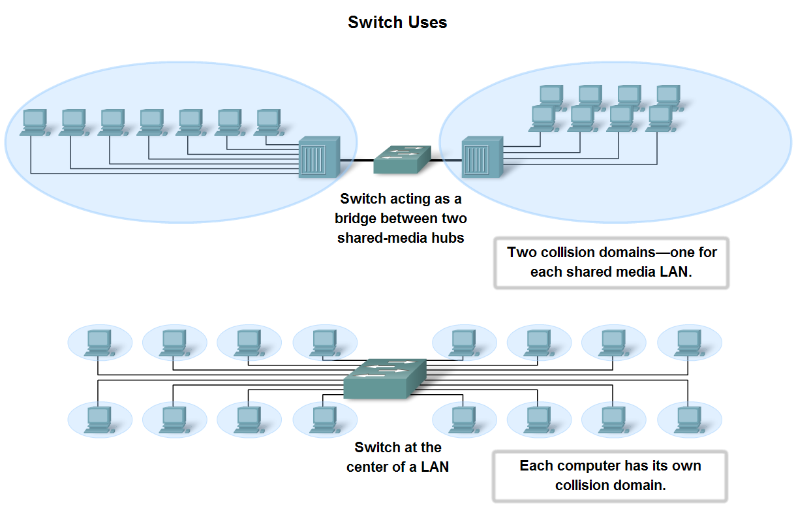
Compare and Contrast the Use of Ethernet Switches versus Hubs in a LAN
Ethernet – Using Switches

Slide 21
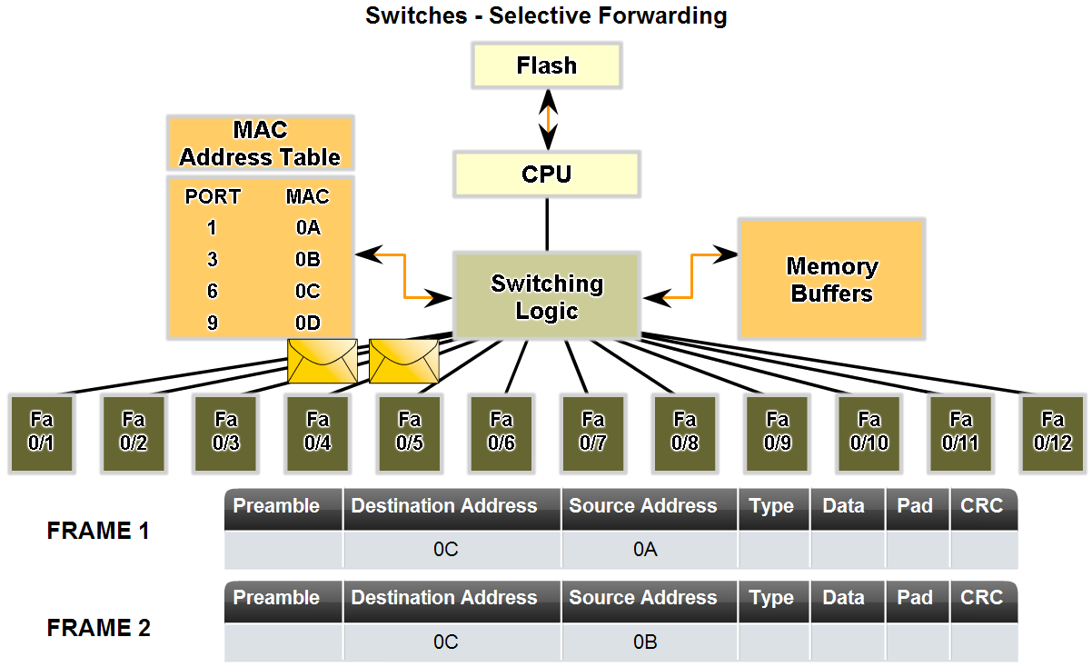
Compare and Contrast the Use of Ethernet Switches versus Hubs in a LAN
Describe how a switch can eliminate collisions, backoffs and re- transmissions, the leading factors in reduced throughput on a hub-based Ethernet network

Slide 22
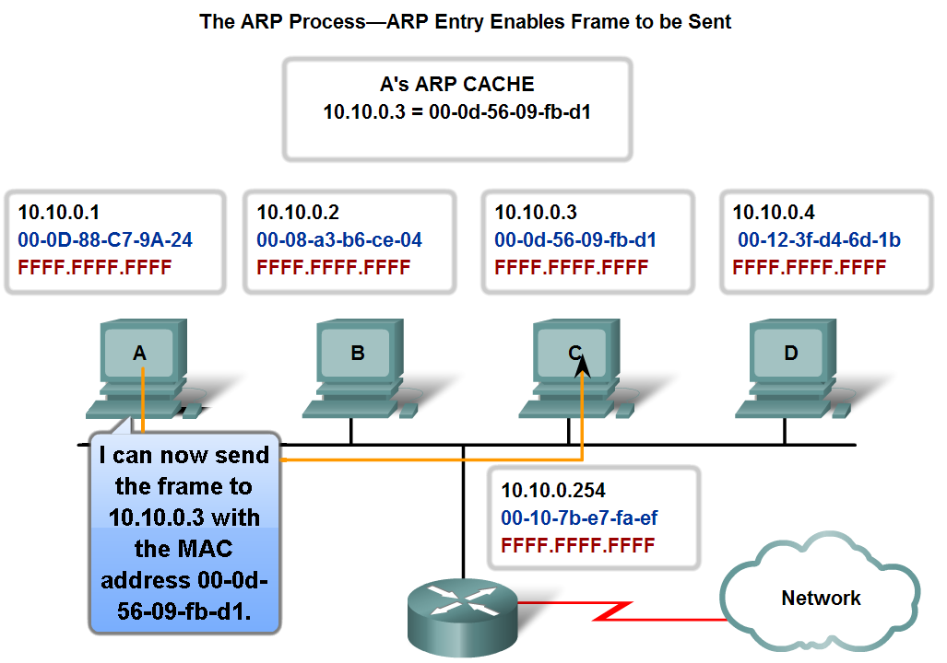
Explain the Address Resolution Protocol (ARP) Process
Mapping IP to MAC Addresses

Slide 23
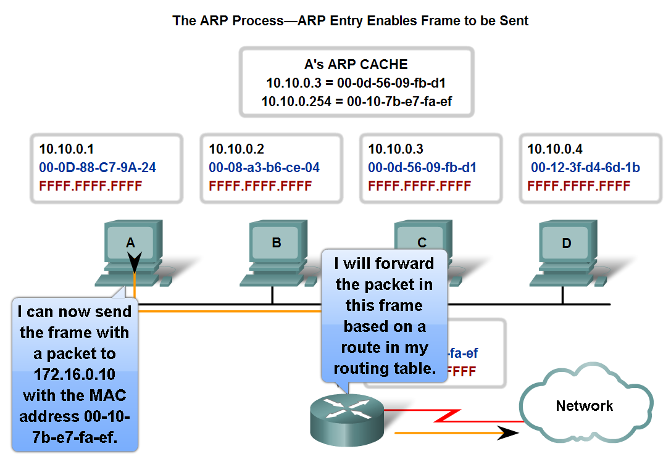
Explain the Address Resolution Protocol (ARP) Process
ARP – Destinations Outside the Local Network

Slide 24
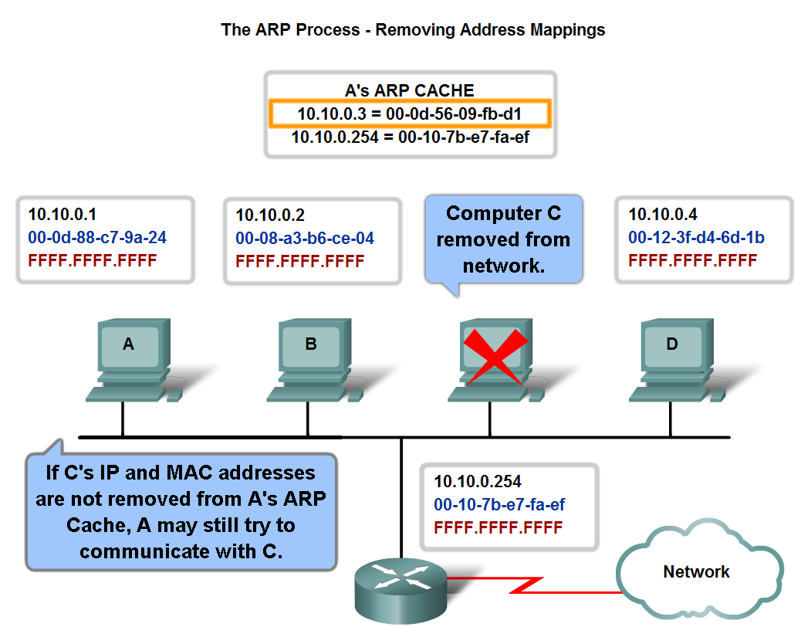
Explain the Address Resolution Protocol (ARP) Process
ARP – Removing Address Mappings

Slide 25
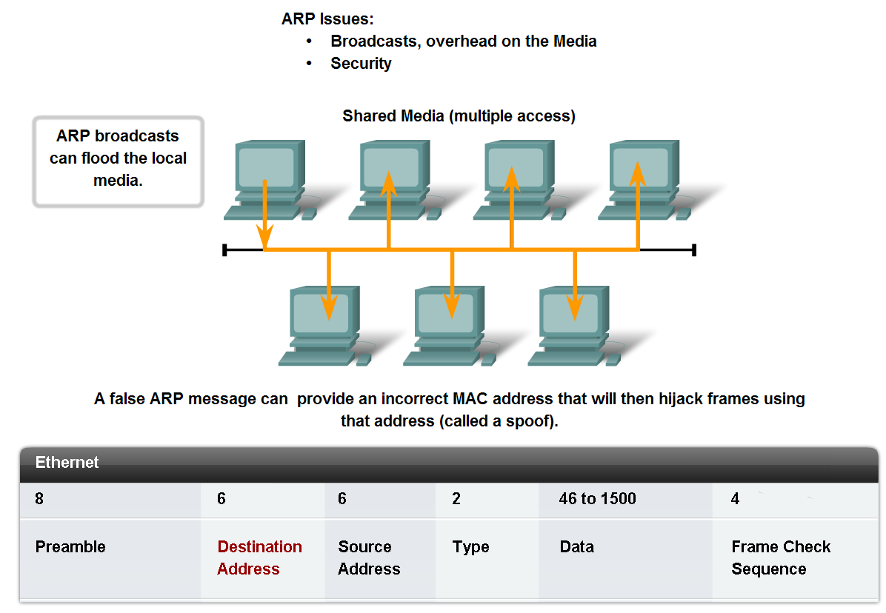
Explain the Address Resolution Protocol (ARP) Process
ARP Broadcasts - Issues

Slide 26
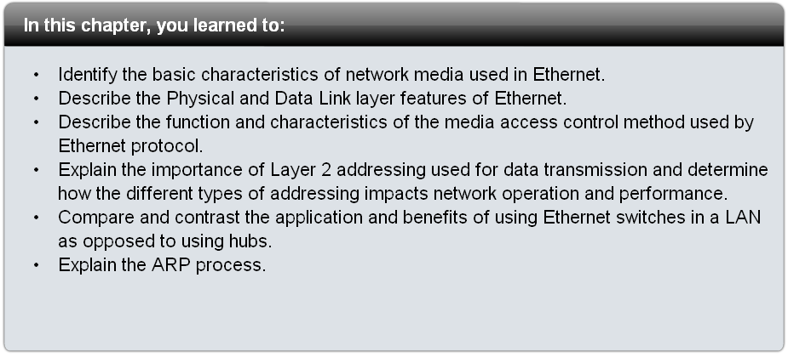
Summary

